Slide 1










Week 4 Profits & Pledge
This week we will focus on these skills!
Notes:
Teacher Notes
Week 4:
This PowerPoint presentation provides…
A reminder of the tasks the pupils will need to think about and complete that week, together with a list of resources that will help them.
An activity that is linked to the tasks for that week to help them to succeed.
Note: Depending on how much time you have in advance of the challenge you may want to do some of the introductory activities earlier.

Slide 2

Bring Your Business to Life!
It’s the final week of the challenge!
By this stage, you will be ready to sell your product or service.
Whether you’re organising a pop-up shop or selling to your friends and family, we know those first impressions count!
If you’re organising a pop-up shop, use your Top Tips for Pop-Up Shops guide to help you plan and prepare.
Think: What makes a successful pop-up shop?
Notes:
Teacher Notes
For Week 4, pupils will be getting ready to run their pop-up shops – use the Top Tips for Pop Up Shops guide to help them through this part of the challenge.
Remind them that they will be using their communication skills as they work collaboratively to sell to the public.
Important Note: We understand that schools may not have the resources to organise pop-up shops for the pupils’ businesses. An alternative would be to encourage your pupils to sell to their neighbours, classmates or family.
Skills Builder Essential Skills
Creativity - Step 3: I generate ideas when I've been given a clear brief
To incorporate the essential skill, ask the following reflective question when covering this slide:
What are some things that you should do, and some things that you should avoid doing?

Slide 3

Payback & Keep the Profits!
You will need:
Fiver Challenge Workbook
Notes:
Teacher Notes
This slide maps out what resources are available to pupils during Week 4.

Slide 4


Payback & Keep the Profits!
What you need to do:
Hold your selling events.
Calculate your profits.
Pay back your £5 pledge (+£1 if you made a profit!).
Decide how to use any profit you might have made.
Evaluate your performance.
Enter the National Competition!
Think: How can we contribute different ideas to our team? What are the best ways of finding out different types
of information?
Notes:
Teacher Notes
Following the available resources for Week 4, this slide maps out what specifically pupils will need to do during Week 4.
Skills Builder Essential Skills
Teamwork - Step 4: I work well with others by supporting them if I can do so.
Teamwork is the skill of working cooperatively with others towards achieving a shared goal. Explain that across the challenge students will need to support each other and discuss what this might look like and why it is important. Students could identify situations for this week’s task where they think they will need to support others.
To incorporate the essential skill, ask the following reflective question when covering this slide:
Why is it important to support others?
Problem Solving - Step 3: I complete tasks by finding information I need myself.
To incorporate the essential skill, ask the following reflective question when covering this slide:
What are the best ways of finding out different types of information?

Slide 5

Journal Changes!
The format of National Competition entries has changed!
Rather than filling in a separate form to reflect on your journey, we are now asking teams to simply submit their completed Workbooks (already containing this information) instead.
We will also be requesting teams submit a 60 second Reflective Video covering why they deserve to win their chosen award category.
A breakdown of the required content will be covered in the next slides.

Slide 6


National Competition
Once you have sold your product or service, you can enter the National Competition!
Each team will need to submit two things.
Part 1
Submit your completed Fiver Challenge Workbook with at least the following pages well-detailed:
Your Business Plan (Pages 10 & 11)
Your Budget (Page 15)
How did your Fiver Challenge go? (Page 19)
Think: Have you learnt anything new from this challenge? Has anyone in your team inspired you? What have you learned from following a brief?
Notes:
Teacher Notes
Once the pupils have run their pop-up shops they can think about entering the National Competition.
Each team will need to submit their completed Fiver Challenge Workbook, which they will have been using throughout the challenge to store details of their business, including evidence of budgeting. There is also space to evaluate what they have learnt throughout the challenge on the final pages, detailing obstacles they have faced and their favourite part of the experience.
There is no longer a journal requirement, as the Workbook replaces this. Please make sure at least the 3 sections shown on the slide are fully completed before submitting.
Skills Builder Essential Skills
Aiming High - Step 4: I work with a positive approach to new challenges.
To incorporate the essential skill, ask the following reflective question when covering this slide:
Have you ever learnt anything new from this challenge?
Teamwork - Step 4: I work well with others by supporting them if I can do so.
To incorporate the essential skill, ask the following reflective question when covering this slide:
Has anyone in your team inspired you?
Creativity - Step 3: I generate ideas when I've been given a clear brief
To incorporate the essential skill, ask the following reflective question when covering this slide:
What have you learned from following a brief?

Slide 7
National Competition
Part 2
Record a 60-second Reflective Video which summarises your business and explains why you think you deserve to win your chosen award category.
If nominating a team member for the Most Inspiring Individual award, this is your opportunity to tell us whom you are nominating and why they deserve to win the award!
Notes:
Teacher Notes
Teams will also need to record a video (no longer than 60 seconds - it can be shorter) that outlines why they think they deserve to win the award category they have chosen to be entered into. Encourage pupils to use the reflections already contained within their Workbooks to pick out positive justifications.

Slide 8

National Competition
Teams can enter any one of the below award categories for a chance to win great prizes and be featured in the Fiver Showcase!
Best Overall Business (5-8 and 9-11)
Fiver for Good (5-8 and 9-11)
Best in Sustainability (5-8 and 9-11)
Most Inspiring Individual (5-8 and 9-11)
Think: How would you put your ideas in a logical order?
Notes:
Teacher Notes
Please note that each team can only be entered for 1 award category (different age brackets count as separate categories), and only 5 teams can be entered into the National Competition per school.
We encourage every school to enter the National Competition and give your pupils the chance to get recognised for their achievements, win great prizes and feature in our Fiver Showcase. This also gives us the opportunity to see the great work children have been doing.
Visit the Fiver website for more information about the competitions, the criteria and how to enter at www.Fiverchallenge.org.uk
You can find the Fiver Showcase for last academic year on our website to show your pupils for inspiration! - https://www.Fiverchallenge.org.uk/en/the-challenge
Good luck and we look forward to seeing what business ideas your pupils have created!

Slide 9

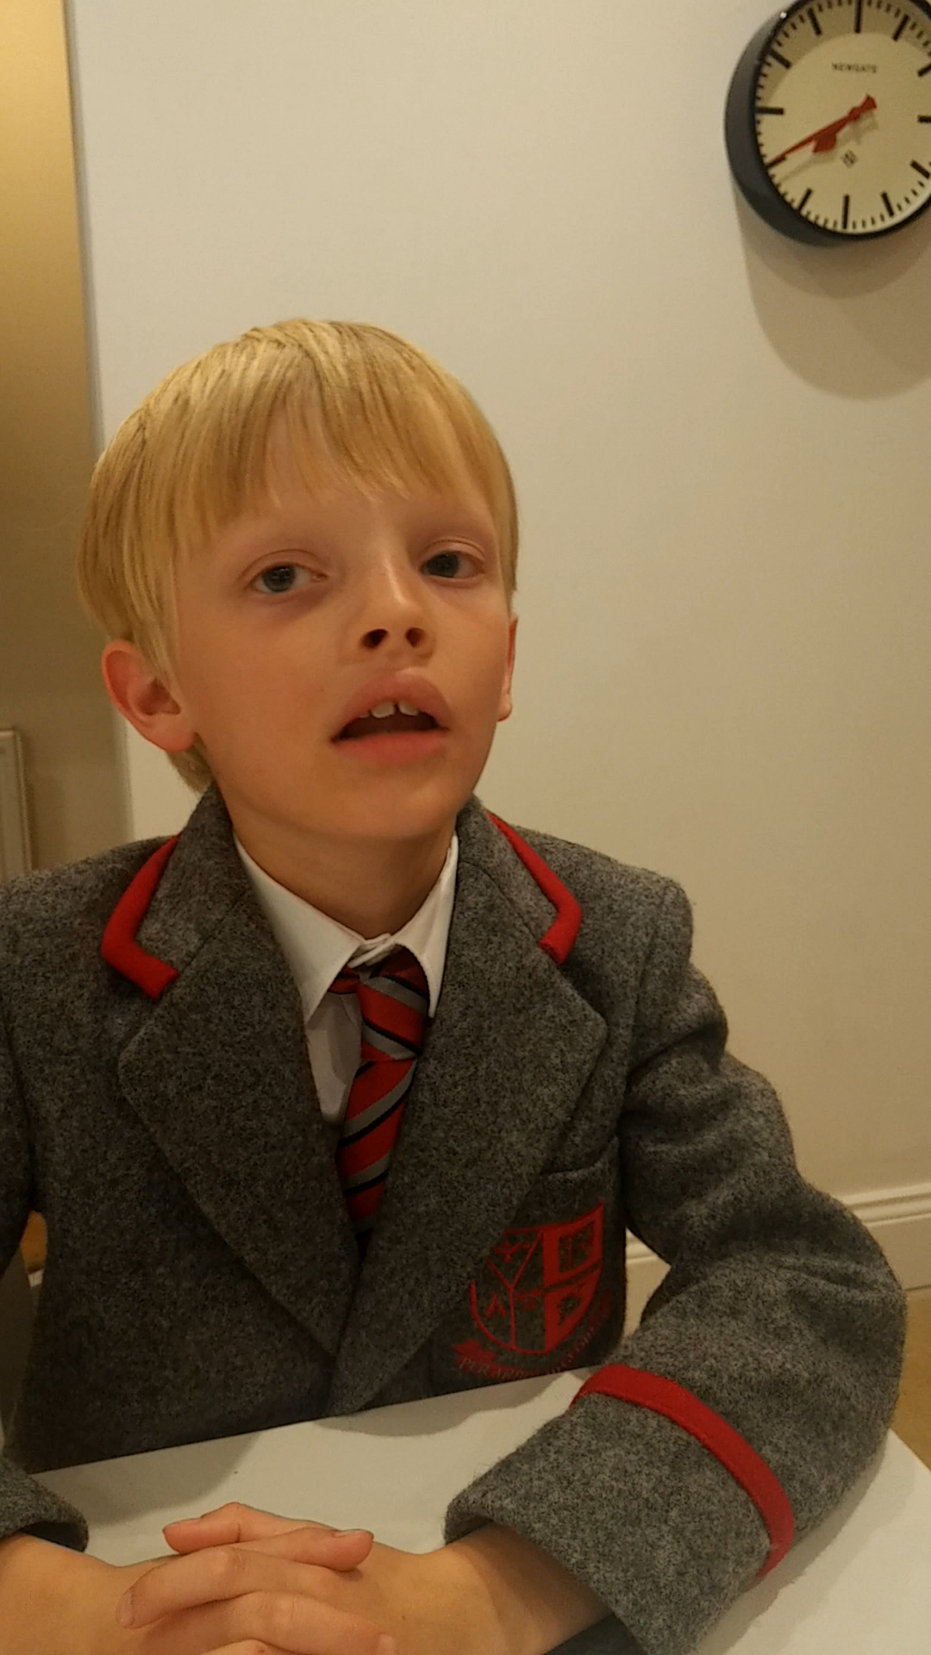

Most Inspiring Individual
Age Group: 5-8 (Winner, 2022)
Don was part of a team called Boxing Love who created boxes to help Ukrainian refugee children feel at home in the UK.
Don helped his team to think sustainably. He also developed great communication and confidence skills through the challenge which helped him enter the school’s end of year talent show!
Let’s hear more from Don!
Think: Do you think you put your ideas in a logical order?
Notes:
Teacher Notes
Here’s a video from a former winner of the Fiver Challenge to inspire your pupils.
Don won the Most Inspiring Individual award in 2022 for the 5-8 age group.
Ask your pupils to watch the video clip and share with a partner what they learn. Encourage them to take notes if they wish!
Skills Builder Essential Skills
Speaking - Step 3: I speak effectively by making points in a logical order
To incorporate the essential skill, ask the following reflective question when covering this slide:
Do you think you put your ideas in a logical order?

Slide 10
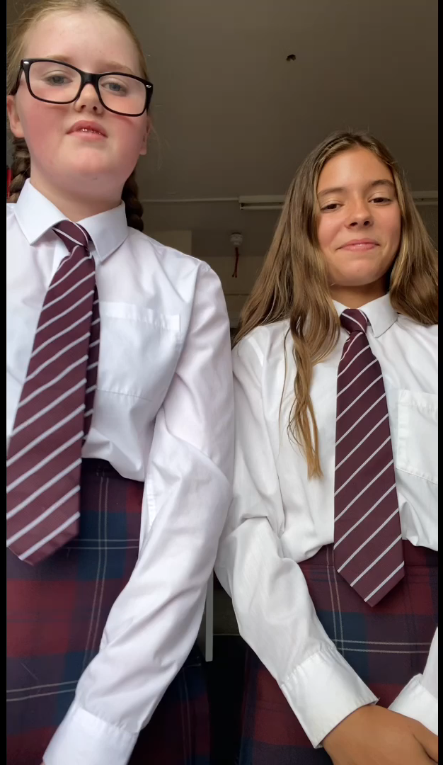
Fiver Best in Sustainability
(Runner Up, 2022)
Harriet and Katy were part of a team called Harriet and Katy’s Scrunchies.
Harriet and Katy sold scrunchies through their school shop, using an old school skirt for their material, as they are required to tie their hair up at school. Talk about spotting a gap in the market!
Let’s hear more from Harriet and Katy!
Think: How would you put your ideas in a logical order?
Notes:
Teacher Notes
Here’s a video from a former runner up of the Fiver Challenge to inspire your pupils.
Harriet and Katy were announced as runners-up for the Best In Sustainability award in 2022.
Ask your pupils to watch the video clip and share with a partner what they learn. Encourage them to take notes if they wish!
Skills Builder Essential Skills
Speaking - Step 3: I speak effectively by making points in a logical order
To incorporate the essential skill, ask the following reflective question when covering this slide:
How would you put your ideas in a logical order?

Slide 11

Week 4 Recap
You have held your selling events.
You have calculated your profits.
You have paid back your pledge and decided how to spend any profit you have made.
You have evaluated your performance!
You have entered the National Competition!
You have developed your essential skills.
Notes:
Teacher Notes
This slide reminds pupils of what they have achieved at the end of Week 4!

Slide 12

CONGRATS
Well done, you have completed the Fiver Challenge!
Notes:
Teacher Notes
Congratulations, your pupils have completed the Fiver Challenge!
Now that pupils have completed the challenge, they can enter the National Competition.
They’ll be competing against teams and individuals across the UK for the fantastic opportunity to be awarded for their business idea! We love to see the range of entries submitted and are always surprised by the creativity shown by children. We absolutely encourage all schools to enter their teams and individuals, as they could be in with a chance of winning!

